Slide 1
Disaster Ready Fund (DRF) Round Four
Applicant Briefing
Notes:
Presentation prepared by the National Emergency Management Agency to support Lead Agency communications with prospective applicants for Round Four of the Disaster Ready Fund (DRF).
IMPORTANT NOTE: If altering or extracting any part of the presentation, NEMA’s logo should be removed and replaced with the Lead Agency’s logo to ensure material is not misinterpreted out of context or incorrectly attributed.

Slide 3
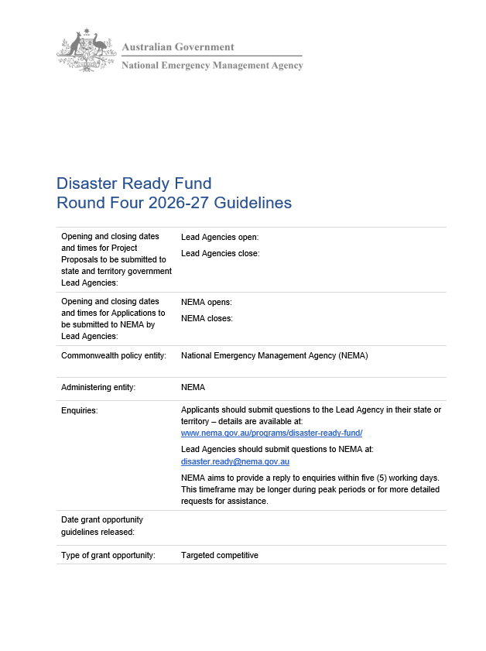
Briefing Overview
Topics covered:
Purpose of the DRF
Funds Available
Eligibility and Project Requirements
Application and Assessment Processes
Key Dates
Resources
Applicants should refer to the DRF Round Four 2026-27 Guidelines published on GrantConnect and NEMA’s website for full details.
Notes:
This presentation will provide a high-level overview of the Disaster Ready Fund (DRF), including its purpose, funds available, project requirements and timelines, with a focus on key changes for Round Four.
Prospective Applicants should familiarise themselves with the DRF Round Four Guidelines, which contain detailed information that may not be covered in the presentation.

Slide 4
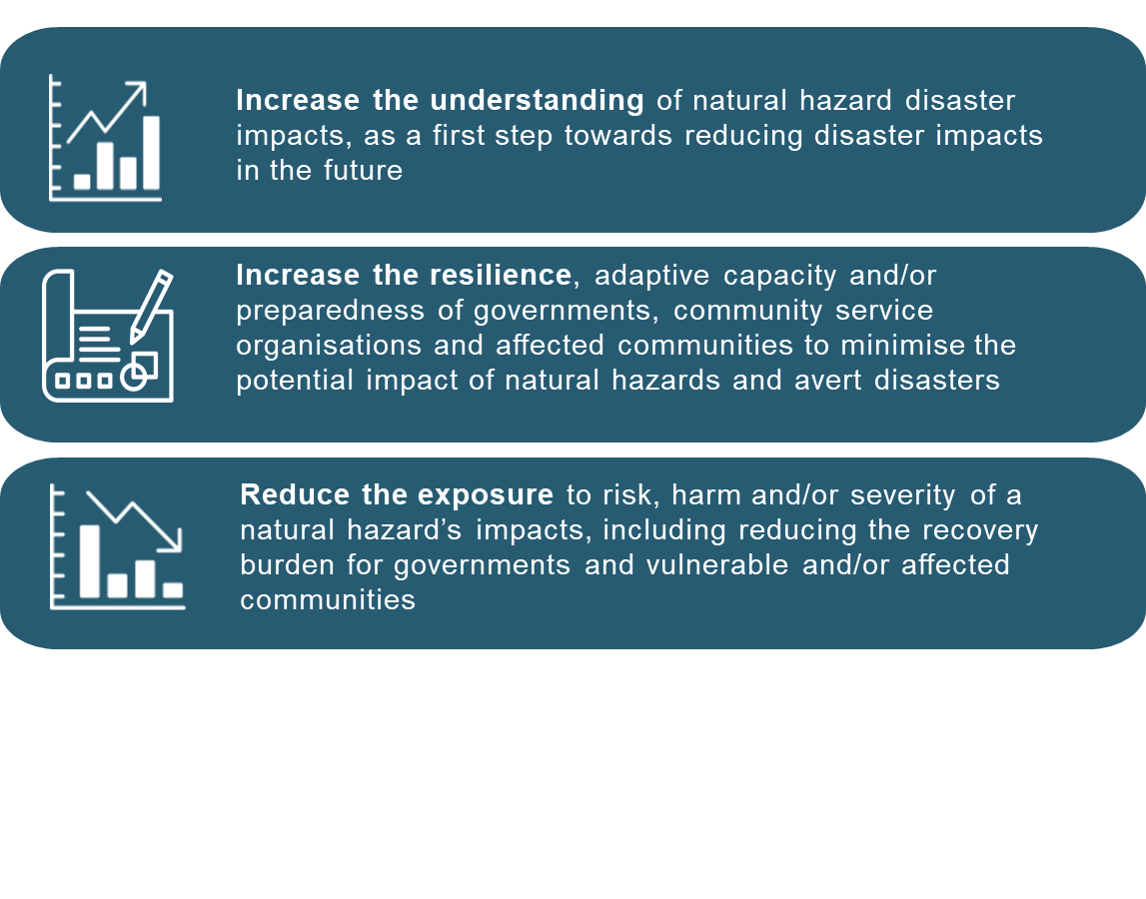
What is the Disaster Ready Fund?
Purpose​
Australian Government program that funds initiatives to reduce natural disaster risks and build community resilience before disasters occur.​
Program Delivery​
DRF is administered by the National Emergency Management Agency (NEMA) in partnership with state/territory governments through Lead Agencies.​
Process​
Grants are awarded annually through a competitive process.
PROGRAM OBJECTIVES
Notes:
What is the DRF? — The Disaster Ready Funding (DRF) is the Australian Government’s main program for supporting projects that help communities reduce risk from natural hazards and build resilience before disasters strike. It’s focused on prevention, mitigation, and preparedness—not emergency response. Examples of possible outcomes include fewer homes flooded, safer ways to evacuate, stronger community readiness, and better planning for future infrastructure.
How DRF Works — Funding is delivered through the National Emergency Management Agency (NEMA), working with states and territories. Applications are managed by Lead Agencies, which are your first point of contact. You don’t apply directly to the Commonwealth; your Lead Agency guides you through the process.
Competitive Grants — DRF grants are awarded through an annual competitive process. Proposals must meet criteria and are compared to others—so good preparation and quality applications matter. Not all proposals will be funded because each jurisdiction has caps on the number of applications it can submit to NEMA and annual funding is limited.

Slide 5
How much funding is available?
Total Funding Available​
Up to $142.477 million nationally, comprising up to $139.477 million in project funding and $3 million for Lead Agency program administration.​
Project Funding Streams
75% ($104.608 million) for infrastructure projects and 25% ($34.869 million) for other eligible types.​
Project Size​
Projects can vary in size but must be valued at $0.5 million or more in the infrastructure stream and funding requests must not exceed available amounts in each stream.​
Notes:
Round Four of the DRF will invest up to $142.477 million in disaster prevention and resilience; with $139.477 million available for projects and $3 million allocated to Lead Agencies to oversee the delivery of funded projects (implementation, delivery and reporting).
As was the case for Round Three, Round Four prioritises large-scale infrastructure that will deliver enduring disaster risk reduction and resilience benefits for communities, but also supports non-infrastructure projects.
75 per cent ($104.608 million) of project funds is notionally allocated for infrastructure projects, such as cyclone shelters, levees, sea walls and early warning systems.
25 per cent is allocated for other eligible project types ($34.869 million), such as planning for future infrastructure and capacity building.
Infrastructure projects must have a total value of at least $0.5 million (Commonwealth funding and your co-contribution combined). No minimum applies to other project types.
Funding requests can’t exceed what’s available in each stream.

Slide 6
Who can apply?
Typical Applicant Groups​
Applicants include local councils, state or territory government bodies, and eligible First Nations, community and not-for-profit organisations.​ Refer to Guidelines for detailed eligibility criteria.
Application Submission Process​
Applications must be submitted through the relevant state or territory Lead Agency, which reviews and shortlists proposals.​
Early Engagement Important​
Prospective applicants should contact Lead Agencies early to confirm eligibility and understand local submission requirements.
Notes:
First, let's answer the most common question: “Can we apply?” Eligible groups may include local councils, state or territory government bodies, and community or not-for-profit organisations. The specific eligibility details are set out in the Guidelines.
The most important practical step: applications must be submitted through your state or territory’s Lead Agency. This means you prepare your project proposal and send it to the Lead Agency. They review all proposals, may ask for clarifications, and then select a shortlist of the strongest ones to submit to NEMA as formal applications. This process helps align proposals with state and local priorities and manages the large number of potential applications by prioritising the most competitive ones.
Engage early! Contact your Lead Agency as soon as possible to confirm the right submission pathway and understand any local processes, templates, or deadlines. If your project involves multiple jurisdictions, you still need to submit through just one Lead Agency—this avoids confusion later on.
If you think you may be eligible, read the Guidelines and reach out to your Lead Agency to discuss your project idea.

Slide 7
What does the DRF fund?
Activity types | Notional Funding Allocation
Investment in grey infrastructure Investment in green-blue infrastructure (including nature-based solutions) Investment in social infrastructure Investment in natural hazard monitoring infrastructure | $104.608M
Development of business cases and/or feasibility studies for future infrastructure (including investigation, modelling, concept planning and detailed design activities). Capacity and capability building projects that improve the resilience of governments, industries, community sector organisations and/or at-risk communities to the impacts of future disasters. Projects that improve understanding of disaster risks and impacts, including disaster modelling, risk assessments and mitigation plans. | $34.869M
Notes:
There are two main funding categories: infrastructure projects and other eligible (non-infrastructure) projects.
Infrastructure projects involve physical assets that reduce hazard impacts and improve safety—examples include levees, flood structures, cyclone shelters, and evacuation facilities.
Other eligible projects include activities like feasibility studies, business cases, risk assessments, mitigation planning, and capability building.
Applicants should pick the category that best fits their project having regard to the Guideline definitions and noting that requirements can differ (for example, proposals in the infrastructure stream must be supported by cost-benefit analyses and able to commence construction during the funding period).
Simple decision test: If you’re building or upgrading a physical asset, it’s likely infrastructure; if you’re planning, analyzing, or building capability, it’s likely in the ‘other project’ category.
All projects must show lasting benefits and have the primary purpose of reducing disaster risk or building resilience to future hazards.

Slide 8
Which natural hazards are eligible?
Bushfire
Earthquake
Flood (including coastal floods/coastal inundation, riverine floods, and flash floods)
Storm (including electrical storms, rain downbursts, blizzards, snow and hail)
Cyclone (including tropical, ex-tropical, and sub-tropical cyclones, and intense low pressure systems such as east coast lows)
Storm surge (including coastal erosion)
Landslide (including avalanches, mud flows and rock slides)
Tsunami
Tornado
Terrestrial heatwave
Notes:
DRF projects must reduce risk from or build resilience to one or more eligible natural hazards.
Eligible hazards include flooding, bushfire, cyclones/storms, extreme heat, earthquakes, landslides, tsunamis.
Refer to Guidelines for the full and definitive list.
Be aware that there are exclusions, including for some hazards that were eligible under previous rounds (e.g. space weather events, volcanic eruptions).

Slide 9
What makes a strong project?
Address Clear Disaster Risk​
Strong projects identify and address disaster risks using evidence like risk assessments and historical data.
​
Align with Plans​ and National Priorities
Projects should align with local, state and/or national hazard mitigation plans and resilience strategies, and must support one or more national actions under the Second National Action Plan to implement the National Disaster Risk Reduction Framework.
​
Deliver Enduring Benefits​
Projects must deliver lasting risk reduction and resilience benefits beyond the life of the project.
​
Realistic and Achievable​
Projects have clear scope, realistic budgets (prepared by qualified professionals for infrastructure projects), and feasible delivery pathways (including prior consultation with affected communities).
Notes:
DRF is competitive—strong projects have common characteristics.
Clear disaster risk, backed by credible evidence: Use local and state risk assessments, historical data and modeling. Evidence should explain the hazard, what is at risk, and how the project reduces that risk.
Alignment with existing plans and national priorities: Projects should fit within local, state, or national strategies, and must align with one or more national actions under the Second National Action Plan. If plans are still in development, explain how your project supports them.
Long-term benefits: Proposals should show lasting risk reduction and resilience—not just short-term wins.
Realistic and achievable: Projects need a clear scope, sensible budget, and a practical delivery plan that has the support of affected communities. Assessors look for deliverability within time and cost constraints.
Tell a clear story—risk, solution, benefits, and delivery plan.

Slide 10
Priority areas for Round Four
Large-Scale Infrastructure
75 per cent ($104.608 million) of project funds have been allocated for large (>$0.5m total value) infrastructure projects such as cyclone shelters, levees, sea walls and early warning systems that will deliver enduring disaster risk reduction and resilience benefits for a community or communities.
Construction-Ready Infrastructure​
All infrastructure projects must be able to begin building within the funded period. Those that will be construction-ready upon commencement (i.e. once implementation plans are endorsed and projects begin, anticipated from mid-2027) will be preferenced by the Commonwealth where applications are similarly rated.​
Insurance Co-Benefits​
Risk reduction projects with demonstrated co-benefits for insurance (e.g. reduced premiums) will similarly be preferenced.​ Applicants should consider partnering with experts and provide relevant evidence (refer to Guidelines for examples) to substantiate any insurance claims.
Notes:
The Australian Government has identified a number of priority areas for Round Four funding.
Large-Scale Infrastructure: 75% of project funds—about $104.6 million—are set aside for large infrastructure projects over $0.5 million, such as cyclone shelters, levees, sea walls, and early warning systems. These projects are designed to provide long-term disaster resilience for communities.
Construction-Ready Infrastructure: All infrastructure projects must be able to start construction within the funding period. Those prepared to begin construction once implementation plans are approved, expected from mid-2027, will be preferenced by the Australian Government where applications are similarly rated.
Insurance Co-Benefits: Projects offering additional benefits related to insurance will also be preferenced. The Australian Government will test claims with relevant experts as part of its assessment process.

Slide 11
Project timeframes
Three-Year Project Limit​
Projects must be scoped to run no longer than three years.​
Infrastructure Project Requirements​
Infrastructure projects require readiness to start construction during the project period, preferably upon commencement.
Project Commencement
Projects can formally commence* once schedules have been signed, individual grant agreements are in place and implementation plans are approved, expected from mid-2027.
*Early commencement may be possible using applicant funds with Lead Agency approval. Refer to Guidelines for detail.
Notes:
Under Round Four, DRF projects can run for a maximum of three years.
For infrastructure projects, applicants must be able to begin construction within the project timeframe. All planning, approvals, and procurement must therefore occur prior to or at the outset of the project three years, noting that the Australian Government will not fund projects with potential impacts on matters of national environment significance.
For non-infrastructure projects, the three-year limit applies to deliverables like business cases, feasibility studies, risk assessments, and capability programs. Plan milestones and completion dates accordingly.
Assessors value projects with realistic, phased schedules and clear pathways to outcomes. It is accordingly important not to overpromise. Propose only what you can confidently deliver in three years, with evidence of readiness.
Projects can formally commence once schedules have been signed, individual grant agreements are in place and implementation plans are approved, expected from mid-2027.

Slide 12
Business as Usual (BAU)
BAU Exclusion
DRF funding does not cover routine capital works or essential services that government bodies are expected to fund internally.​
Purpose of the Rule​
The rule ensures DRF funds add value by supporting additional risk reduction measures beyond regular budgets and activities.​
Examples of BAU vs non-BAU​
Routine maintenance and repairs are BAU, whereas a new flood levee is a significant, non-standard addition.
Applicant Guidance​
Applicants are required to explain why projects are not BAU and should consult Lead Agencies if uncertain. Further examples and guidance are provided in Appendix C of the Guidelines.
Notes:
DRF funding cannot be used for Business as Usual (BAU) activities that are part of an organisation’s standard operations, maintenance, or services.
This rule exists to make sure DRF funding adds value and doesn’t replace or shift existing funding obligations.
Examples of BAU: routine road maintenance, existing asset repairs and replacement, staffing for standard service delivery.
Examples of non-BAU work: building a new flood levee or upgrading an evacuation center specifically to reduce disaster impacts.
BAU is assessed against the Guidelines by the Australian Government’s Assessment Panel on a case-by-case basis.
Applicants:
must clearly explain in their proposals why their project is not BAU (i.e. how the DRF-funded project differs from standard works and services).
should check the Guideline definition, detailed guidance at Appendic C and funded project lists from Round Three for examples in deciding whether to apply and when preparing their justification.
should consult their relevant Lead Agency early if unsure about BAU.

Slide 13
Co-contributions
Definition​
Co-contribution is the applicant's or partners' share of total project costs alongside Commonwealth funding.​
Purpose ​
Co-contributions encourage shared investment, strengthen ownership, and amplify impact.​
Tiered Approach​
Reduced co-contribution rates apply to certain groups with limited financial capacity. For Round Four, this includes but is not limited to state and territory government bodies in smaller jurisdictions. See guidelines for details.
Practical Guidance and Transparency​
Plan budgets carefully, document funding sources, and clearly show financial contributions.
Notes:
Co-contributions are the portion of project costs contributed by the applicant and/or partners in addition to Commonwealth funding.
All DRF projects require a co-contribution. This promotes shared investment, increases project ownership, and amplifies the impact of projects.
However, some applicants may qualify for reduced co-contribution rates—this includes First Nations organisations, councils in remote areas or with low-rate bases, not-for-profit organisations and certain smaller jurisdictions. Check the Guidelines for details.
It is important that Applicants clearly show what funding is being requested from the Commonwealth and what the applicant is contributing in order to demonstrate that co-contribution requirements are met.

Slide 14
Application and Assessment Process
Step 1: Proposal Submission​
Applicants submit proposals to the relevant Lead Agency by local deadlines. Refer to Lead Agency websites for dates, submission processes and templates, noting that these may vary between jurisdictions.
Step 2: State and Territory Review​
Lead Agencies review proposals for eligibility and merit, assign ratings against state and territory priorities, and obtain endorsement from state and territory emergency management ministers.
Step 3: National Submission​
The most competitive proposals (based on eligibility and merit) are submitted by Lead Agencies as formal applications to the National Emergency Management Agency (NEMA) for Australian Government assessment.​
Steps 4 & 5: Panel Assessment and Ministerial Decision​
NEMA determines eligibility and applications are assessed against the published criteria by an expert Panel, which makes funding recommendations to NEMA and the federal Minister for Emergency Management for final decision.
Notes:
The application and assessment pathway involves five key steps.
Step 1: Applicants submit proposals to their relevant state or territory Lead Agency by the local deadline. Typically, although not always (e.g. some multi-jurisdictional and national projects), this will be the Lead Agency in the jurisdiction where the project will be delivered. Processes and templates for submitting proposals may differ between jurisdictions, so check their websites early.
Step 2: Proposals are reviewed by Lead Agencies for eligibility, merit, and alignment with state and territory priorities. Not all will proceed to the next step—competition is high.
Step 3: Lead Agencies submit their most competitive proposals to NEMA for assessment by the Australian Government.
Step 4: NEMA checks eligibility and an assessment panel reviews applications against the published criteria. Specialist input may also be sought (e.g. from insurance experts) as part of this step.
Step 5: Ministerial decision—recommendations are provided and outcomes announced.
An indicative timeframe for all steps is provided in the Guidelines.
Remember, the DRF is a competitive, merit-based grant opportunity administered in collaboration with state and territory governments.
The process is structured to provide opportunities for a wide range of stakeholders to participate, while recognising the respective roles and responsibilities of different levels of government for emergency management. For example, state and territory involvement in the DRF process:
helps to ensure proposals from local communities are aligned with state and territory risk mitigation plans and priorities for investment in resilience
fosters collaboration between applicants and state and territory governments through joint proposals and co-contributions
recognises that state and territory governments have primary responsibility for protecting life, property and the environment during crises.
Lead Agencies are the main point of contact for applicants—seek guidance and feedback, even if your proposal doesn’t progress.

Slide 15



Timeline
Application Open
29 May – 1 July
Commonwealth Assessment
Late Aug - Oct
Outcome
From late October
Lead Agency Review
2 Jul – 25 Aug
Notes:
Key dates for DRF Round Four are:
Project proposals to Lead Agencies open on 29 May 2026
Project proposals to Lead Agencies close on 1 July 2026 (roughly 5 weeks later)
Review of project proposals by Lead Agencies commences and applications to NEMA open on 2 July 2026
Review of project proposals by Lead Agencies concludes and applications to NEMA close on 25 August 2026 (roughly 8 weeks later)
Assessment of Lead Agency Applications by the Australian Government will occur across August to October 2026
Outcome announcements are expected to occur from late October 2026.
Schedules are anticipated to be signed and funding delivered to Lead Agencies from Jan to March 2027
Implementation Plans are anticipated to be endorsed and payments to applicants from Lead Agencies can be made from mid 2027
If asked: Why has the application period been shortened compared with Round Three?
Application and assessment periods and processes have been streamlined for Round Four to allow delivery between higher risk weather seasons (when applicants and Lead Agencies are typically under pressure responding to disaster events), to better align with government budget cycles and to minimise the risk of delays due to upcoming state elections. While not without some drawbacks (e.g. less time to develop project proposals), these changes respond to feedback from stakeholders over successive rounds.

Slide 16
Resources and Help
Lead Agency Contact​
Lead Agencies are the first point of contact for application questions and guidance for Round Four submissions.​ Refer to NEMA’s website for a list of all Lead Agencies and their contact details. Lead Agencies will escalate matters to NEMA where needed.
Available Resources​
Applicants can access a range of resources such as application forms, templates, and checklists on Lead Agency websites to prepare submissions.​ NEMA has supplied Lead Agencies with a suite of tools to support the application process and will additionally publish FAQs on its website. For the latest Guidelines, always refer to GrantConnent.
Early Engagement Encouraged​
Applicants should contact Lead Agencies early with project ideas for tailored guidance and to ensure effective use of resources.
Notes:
The relevant Lead Agency is your main point of contact for Round Four—submit applications through them, not directly to NEMA.
Your Lead Agency can help with:
Eligibility questions
Advising on funding streams
Explaining local submission processes
Guidance on business as usual, co-contributions, and documentation
Lead Agencies also publish all of the resources that you will need to submit proposals in your jurisdiction – e.g. application forms, templates, etc. Please refer to the relevant Lead Agency website for copies, noting that resources and submission requirements may differ between jurisdictions.
For the official grant opportunity guidelines, always refer to GrantConnect. NEMA will also publish FAQs on its website.

